Slide 1
Simulating exoplanet direct imaging: from science photons to bits
Maxime J. Rizzo
Postdoctoral Fellow, NASA GSFC
Contributors: Neil Zimmerman, Aki Roberge, Tyler Groff (NASA GSFC)
Ewan Douglas (MIT/Cahoy Lab)
Laurent Pueyo, Chris Stark (STScI)
John Krist (JPL)

Slide 2
Overview
WFIRST coronagraph basics
The Haystacks project
Unit conversion
Shaped pupil simulations
Detector noise
Simple post-processing

Slide 3
Overview
WFIRST coronagraph basics
Coronagraph intro (modes, etc)
Targets
Context of modeling effort (JPL, IFS, etc)

Slide 4
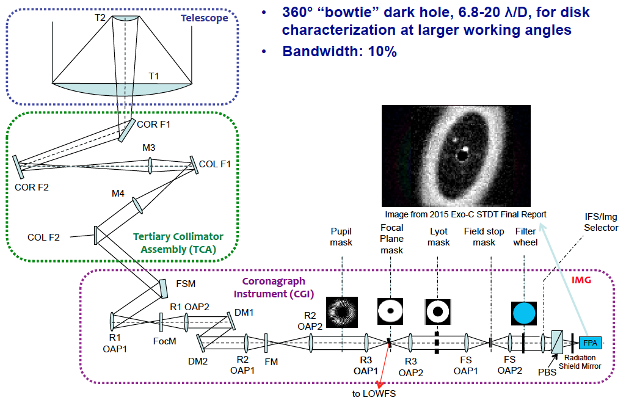
WFIRST Coronagraph

Slide 5
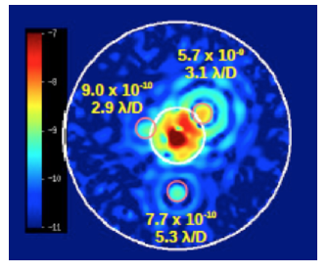
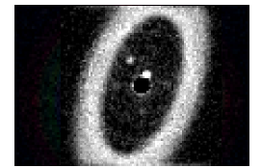
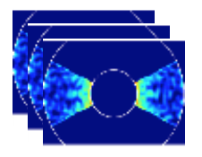
Performance and targets
<1e-8 raw contrast
Expected >10x gain in post-processing
3 modes:
Hybrid Lyot
Shaped Pupil – Disk mode
Shaped Pupil – bowtie + Integral Field Spectrograph
>16 currently known planet candidates

Slide 6
Context of effort
JPL is modeling lead
High-fidelity model of the CGI with their software “PROPER”
Includes dynamic LOWFS and DM corrections
Takes many days to run a typical observing scenario
Does not include detector noise and post-processing techniques
NASA Goddard is building IFS
Need simulations to study trade-offs and optimize parameters
Science investigation teams (SITs) need ‘toy models’ to play with to refine the post-processing factor gain, tune the science

Slide 7
The ‘Haystacks’ project

Slide 8
Overview
The Haystacks project
Context
Stars & Planets
Dust
Noise and confusion
Galaxies
Local dust
Background stars
Orbital dynamics
Deliverables
Created as a benchmark

Slide 9
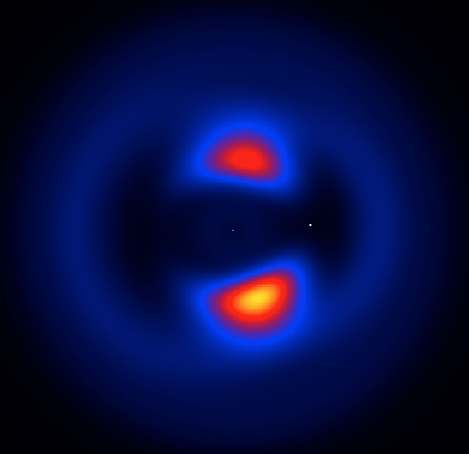
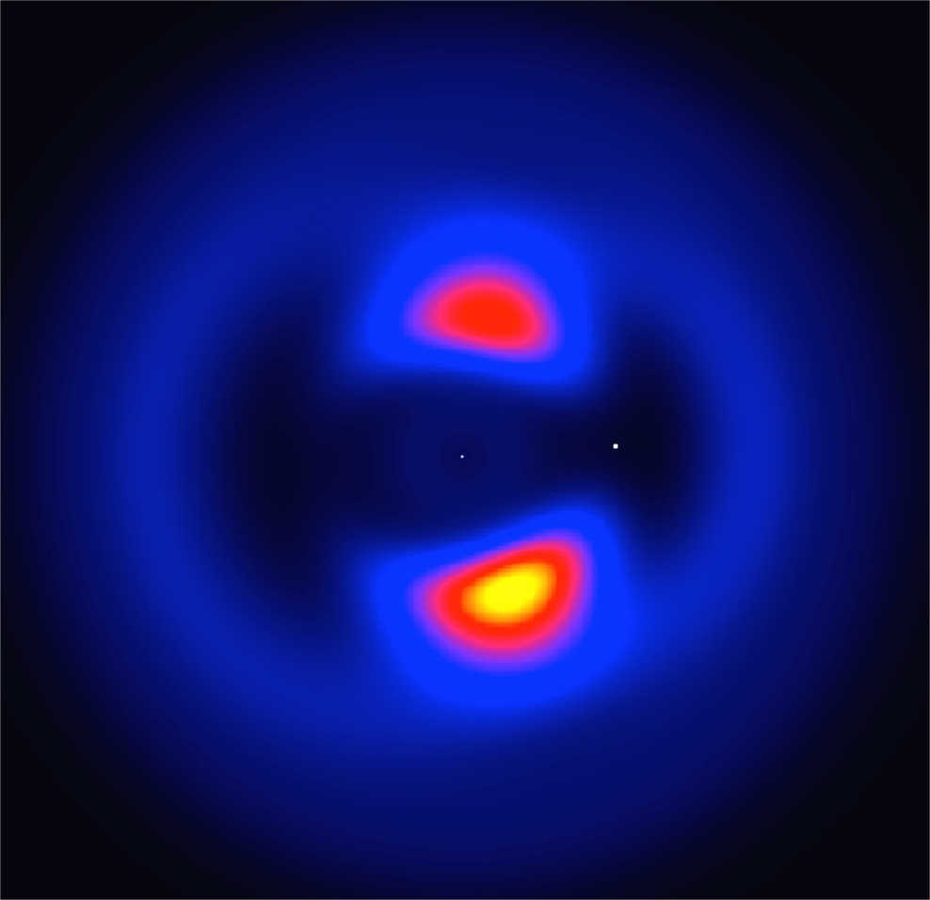
CGI simulated scenes: “Haystacks”
Lead by Dr Aki Roberge at GSFC
Suite of models of realistic extrasolar systems
Spatially and spectrally resolved

Slide 10
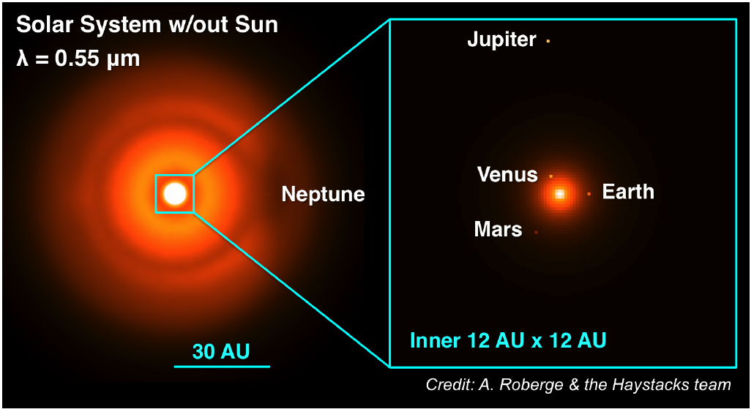
Solar system

Slide 12
Dust
Dust structure is modeled by C. Stark at STScI
Uses N-body simulations
Several grain populations
Includes grain-grain collisions
Tied to planetary architectures
Radiative transfer code converts dust density to fluxes
Dust scatters starlight
Emits its own light by absorbing stellar photons
Can vary the overall intensity, the inclination the stellar spectrum, etc

Slide 13
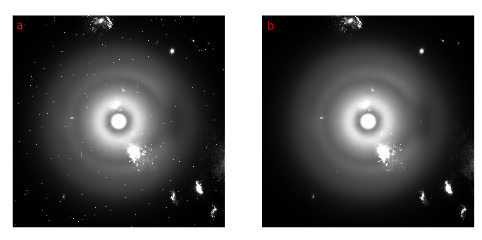
Galactic background

Slide 14
Haystacks features
Models orbital dynamics
Planets orbit around the star
Dust structure rotates appropriately
Background cubes are provided separately so can be moved to simulate proper motion
We will distribute 2 solar system models (Roberge et al., in prep):
Modern system
Archean Eon (3.5 Gyr ago)
We want to become the benchmark of future coronagraphs

Slide 15
It’s all about the units
Convert units
Section on its own! Just make the units work and you will avoid mistakes (use astropy.units)
Haystacks gives Watts per Hz per m2
Goal is to calculate how many photons per second enter the telescope in the desired bandpass
Usually things are defined/referenced in Vband
Obtain the bandwidth in Hz
Obtain the mean photon energy in Joules
Obtain the effective aperture of the telescope in m2
Things to watch out for:
Stellar temperature/type, which change the shape of the stellar spectrum
If you are trying to determine photon flux in another band, first determine the scaling factor in the reference band, then use a blackbody function to obtain the ratio of your band to Vband!

Slide 16
Overview
Shaped pupil simulations
Not a convolution! -> PSF fluctuates on various timescales and spatial frequencies
Reaction wheels, pointing jitter, thermal drifts
LOWFS senses the variations but corrects only imperfectly
First approach:
Look up OPD residual map fluctuation properties (spatial and time scales)
Reproduce an OPD map time series
Apply it to a model PSF using webbpsf to build a time series of stellar PSFs
Calculate off-axis PSF for each off-axis pixel
Have a reference star and a target scene, subtract the two

Slide 17
Shaped pupil simulations

Slide 18
Overview
Not a convolution!
PSF fluctuates on various timescales and spatial frequencies
Reaction wheels, pointing jitter, thermal drifts
LOWFS senses the variations but corrects only imperfectly
First approach:
Look up residual OPD map fluctuation with time (Krist et al.)
Randomly generate an OPD map time series
Apply it to a model PSF to build a time series of stellar PSFs
Calculate off-axis PSF for each off-axis pixel
Produce ideal PSF for reference; apply detector noise to target scene
Subtract reference from target!

Slide 19

CGI WFE simulations

Slide 20
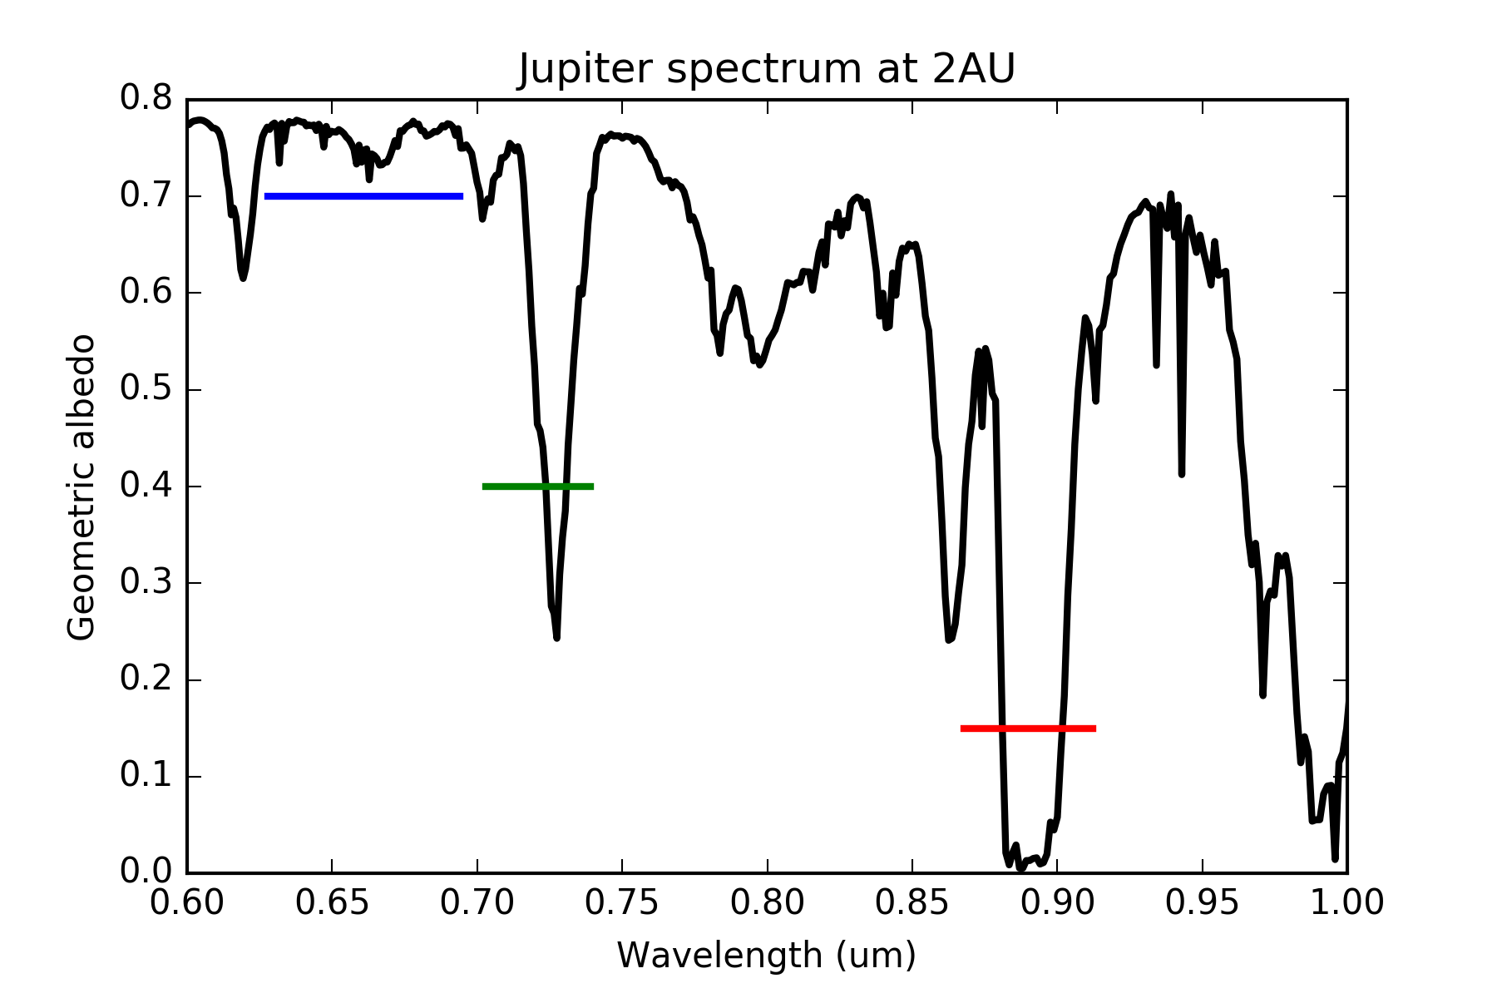
WFIRST bands
F661
F721
F883
Spectrum from Cahoy+ 2010

Slide 21
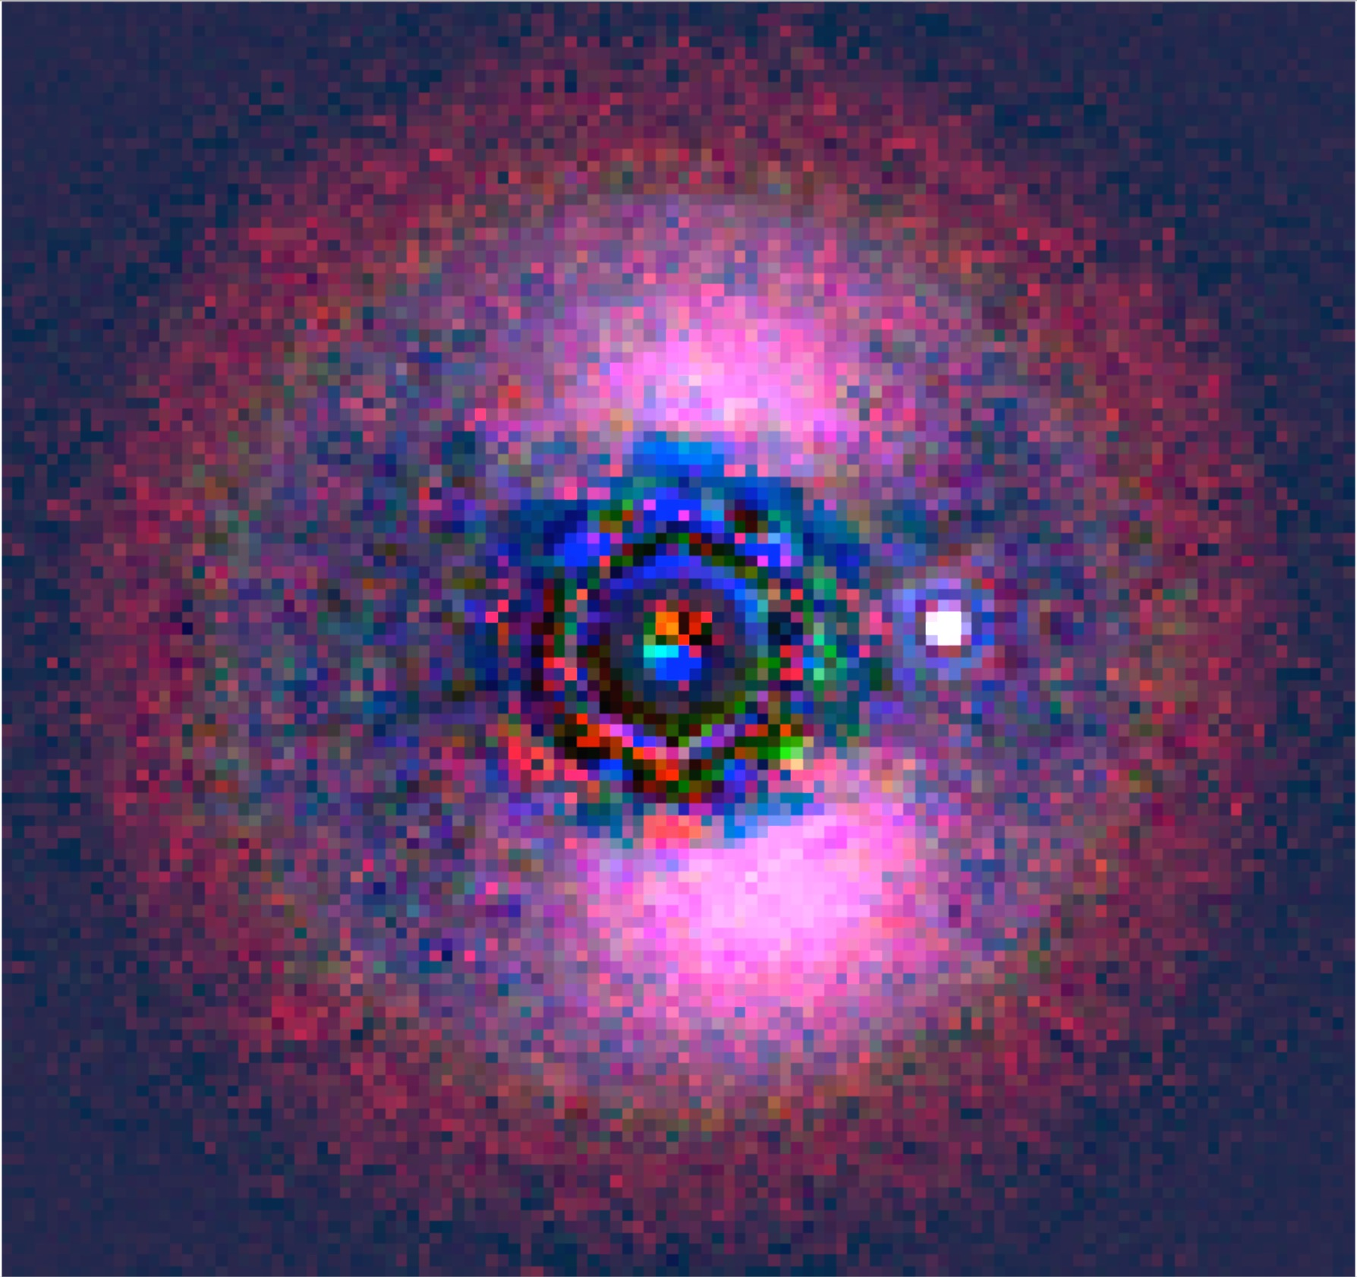
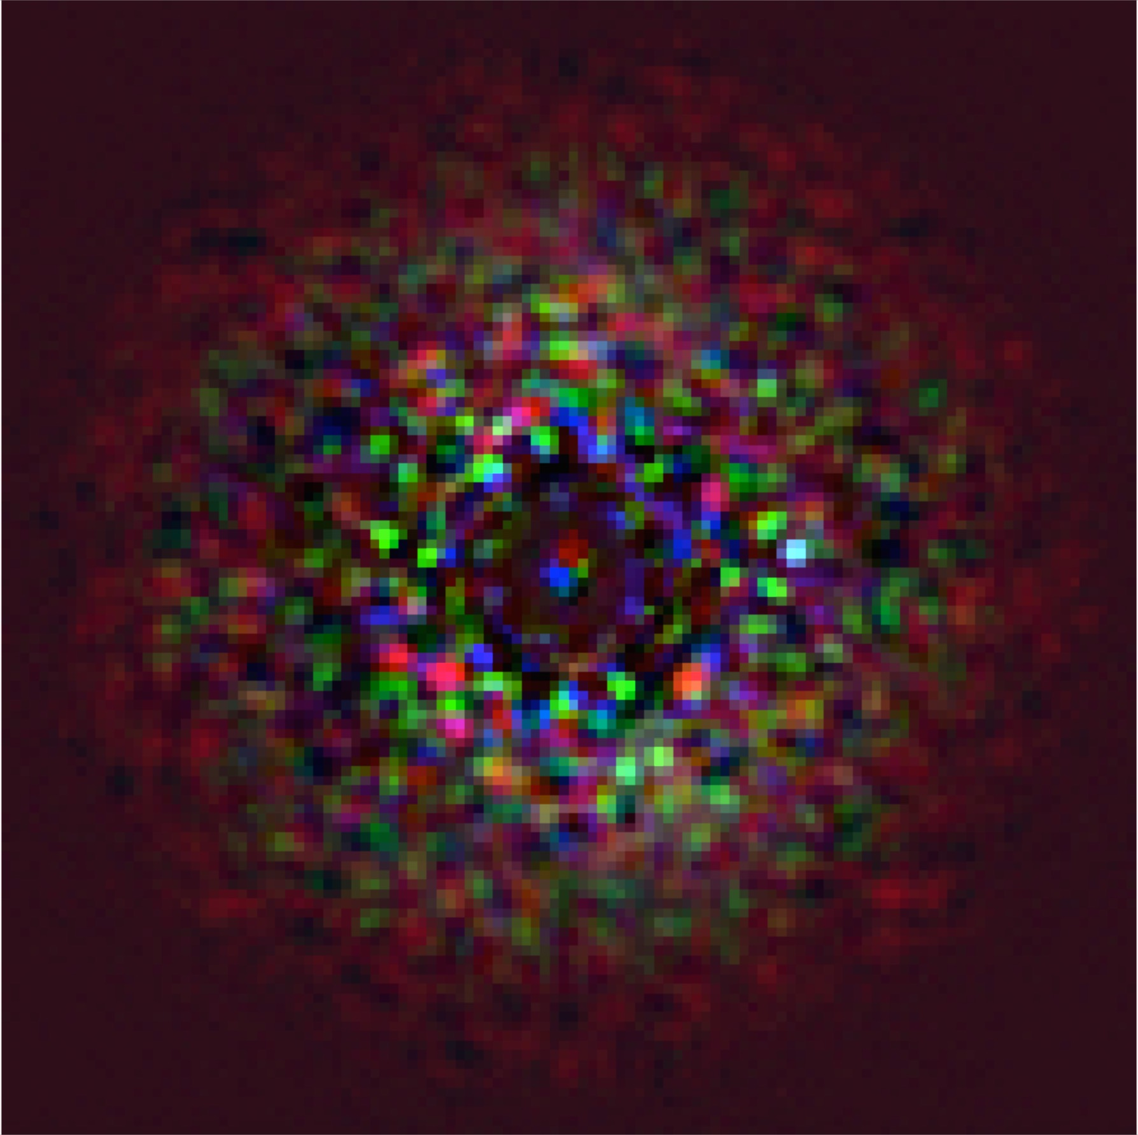
Varying high-order WFE
10pm
100pm

Slide 22
Shaped pupil simulations
Second approach:
Obtain high-fidelity model from JPL
Correct observing scenario: look at the reference star; look at the target star, and roll
Generate the off-axis PSF on our own
Produce ideal PSF for reference; apply detector noise to target scene

Slide 23
RMS WFE from JPL model
(pm)
Input low-order
error (Z5-Z36)
DM corrected
(16 bit DAC
Randomized)
DM corrected
(16 bit DAC)
DM corrected
(No DAC)

Slide 24
SPC IFS results

Slide 25
Shaped pupil simulations
Model detector noise
Noise contributors:
Read noise, Poisson noise, CIC noise, dark current
Electron multiplying noise & threshold
Traps!
Severely impacts things when in low-light environments

Slide 26
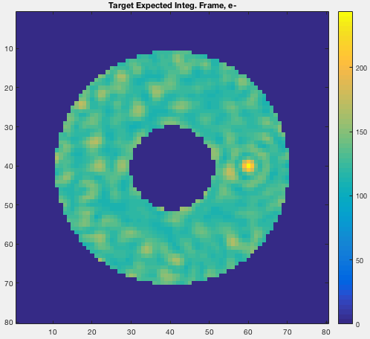
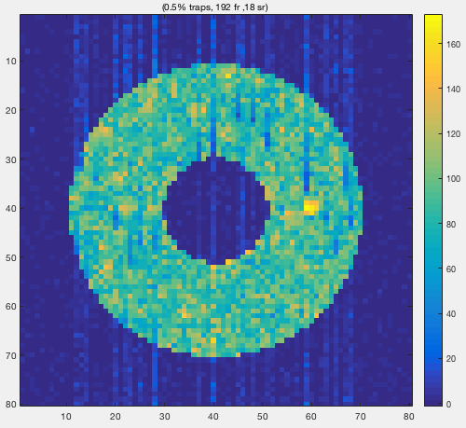
Traps

Slide 27
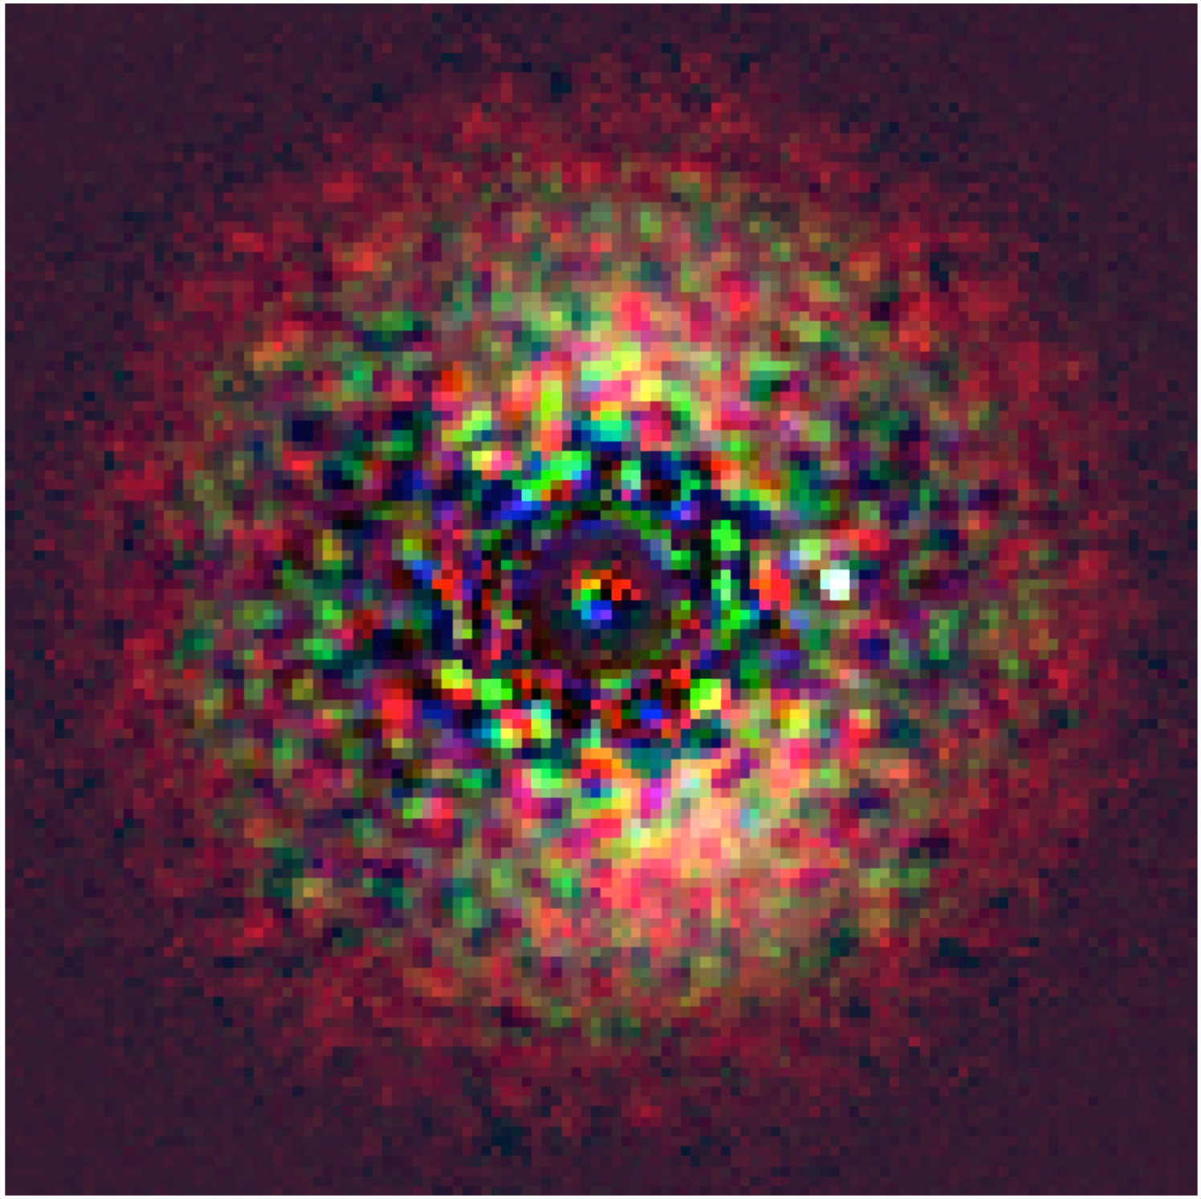
Next steps
Model all WFIRST bands
Unit testing
EM+Traps detector model
Incorporate with IFS simulator
Staged sharing with the community
Soon: source code and example notebooks
Later: web-based tool where users can update a model scene and get back a simulated image (similar to WFI tool STIPS*)?
*http://www.stsci.edu/wfirst/software/STIPS

Slide 28
Backup slides

Slide 29
Coronagraph model
Shaped pupil “disk mode”
6->20 lambda/D
Using webbpsf/POPPY
Created a look-up table of off-axis PSFs for every sampling element for each filter (~10GB total)
Used lambda/4D @ 661nm as spatial sampling element
For any input field, bin to correct spatial sampling and multiply each pixel by corresponding off-axis PSF

Slide 30
OPD errors
Generated 100 realizations of OPD wavefront error
Both low-order and high order
High-order WFE are scalable
Averaged the first 50 realizations to generate a ‘library PSF’
Averaged the last 50 to generate the ‘observed’ star, add to the scene

Slide 31
Detector sampling and noise
Assume the detector pixel is lambda/2D @ 661nm
Assume an efficiency factor at the CGI entrance from J. Krist
webbpsf simulates CGI efficiency
Observed 6, 3 and 3 hours in F661, F721, F883
Divide exposure time into 100 s exposures
Assume only Poisson noise on the observed scene, no noise on the ‘library PSF’
Assume QE, dark current, CIC, read noise from Harding et al. 2016 paper
No photon counting mode, EM-noise, or traps

Slide 32
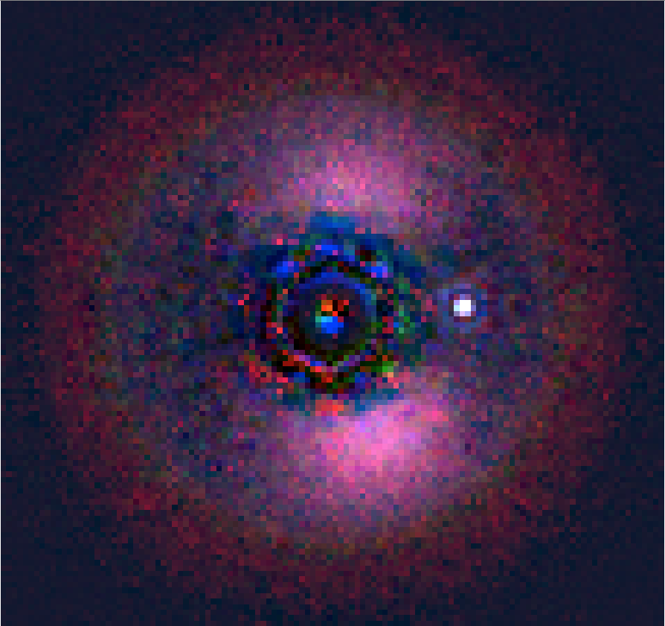
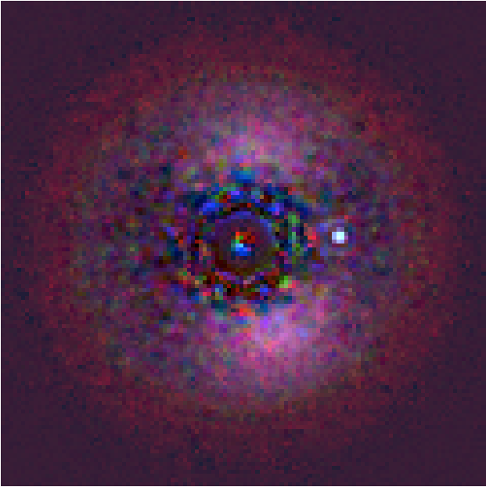
Varying high-order WFE
10pm
25pm

